Slide 1

Angela Hyson
DATA 4390
May 5, 2025
Case Study into People Analytics
Human Resources into Organizational Health

Slide 2
Introduction
Case Study: People Analytics
1
Organizations today rely on data driven decisions and insights to stay efficient and competitive.
HR departments use KPIs, predictive models, dashboards, and evaluations to optimize performance.
People analytics help HR teams understand and improve workforce.
Goal: Serves as a case study in People Analytics to optimize company performance and overall health using data science to drive HR insights and decision-making.

Slide 3
Objectives
Case Study: People Analytics
2
Analyze organizational health using key HR metrics and statistical techniques.
Develop a predictive model to forecast employee terminations.
Create an interactive dashboard for data visualization and insights.
Deliver actionable insights to enhance workforce satisfaction and performance.

Slide 4
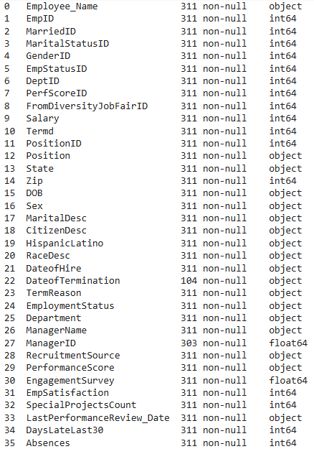
Dataset
Case Study: People Analytics
3
Source: Kaggle HR Analytics Dataset
Original df shape: 311x35
Categories
Employee Demographics→GenderID, RaceDesc, DOB
Job Details→Department, Position, ManagerID
Performance Metrics→PerfScoreID, Absences
Engagement Metrics→EngagementSurvey, EmpSatisfaction
Compensation→Salary
Recruitment→RecruitmentSource, FromDiversityJobFairID
Tenure & Dates→DateofHire, DateofTerm, TermReason

Slide 5
Data Cleaning
Case Study: People Analytics
4
Missing Values
DateofTerm→Kept as Naan
ManagerID→Created mapping dictionary {ManagerName → ManagerID}; if ManagerID was missing, searched for ManagerName and used mapped ID
Ensured Unique Values & Features
Removed leading spaces
Removed Duplicates
Ensured operationalized capitalization

Slide 6
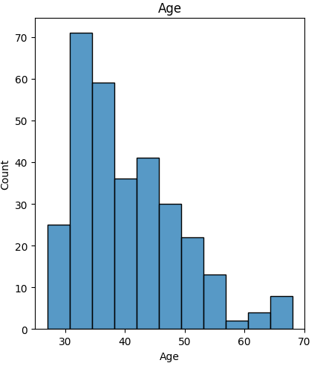
Feature Engineering
Case Study: People Analytics
5
The dataset lacks critical KPIs and employee context, limiting turnover insights and model accuracy. Engineering this data would improve predictive power and business decision-making.
Other Note: Dataset records from 2012 to 2019, hence the reference date is December 31, 2019.
DOB→Age: Prefer numeric over datetime for statistical and modeling.
Used reference date (December 31, 2019) to calculate latest age
After visualization of DOB and Age:
Discovered there are negative ages because there are DOB after the reference date being used.
Many of the negative DOB establish a pattern of years occurring after 2045.
Solution: Assume the DOB entries are entered wrong (e.g. 2067 = 1967), so those years actually occur 100 years prior to the date entered.

Slide 7
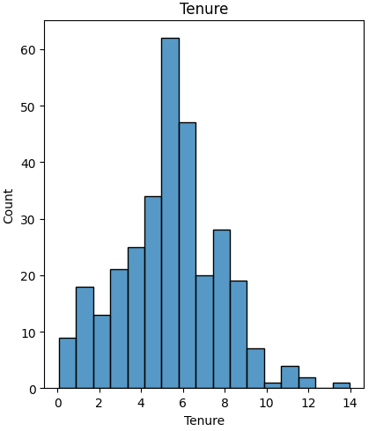
Feature Engineering
Case Study: People Analytics
6
The dataset lacks critical KPIs and employee context, limiting turnover insights and model accuracy. Engineering this data would improve predictive power and business decision-making.
Other Note: Dataset records from 2012 to 2019, hence the reference date is December 31, 2019.
Tenure measures how long employees have worked with the company.
Helps to determine turnover patterns.
Implemented: Computes tenure using termination dates for departed employees and a fixed reference date (2019-12-31) for active employees.

Slide 8
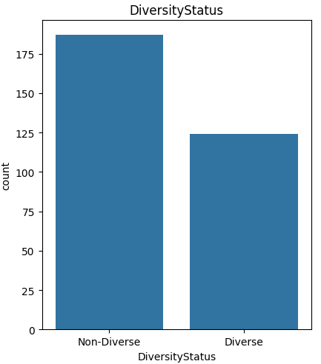
Feature Engineering
Case Study: People Analytics
7
The dataset lacks critical KPIs and employee context, limiting turnover insights and model accuracy. Engineering this data would improve predictive power and business decision-making.
Other Note: Dataset records from 2012 to 2019, hence the reference date is December 31, 2019.
Diversity Status acts as a diverse hire indicator that tracks diversity in hiring practicing.
Measures effectiveness of diversity job fairs.
Supports DEI (Diversity, Equity & Inclusion) initiatives.

Slide 9
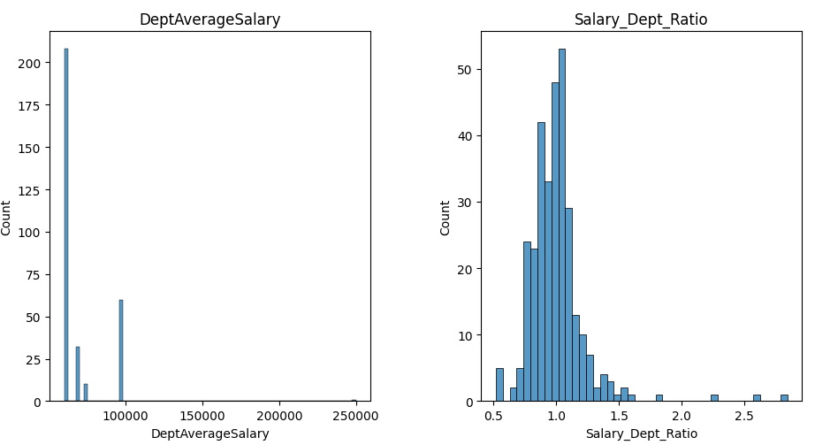
Feature Engineering
Case Study: People Analytics
8
The dataset lacks critical KPIs and employee context, limiting turnover insights and model accuracy. Engineering this data would improve predictive power and business decision-making.
Other Note: Dataset records from 2012 to 2019, hence the reference date is December 31, 2019.
Compensation Benchmarks
Identifies potential pay equity issues
Highlights compensation outliers
Department Average Salary
Salary Department Ratio
>1.0: Paid above department average
<1.0: Paid below department average

Slide 10
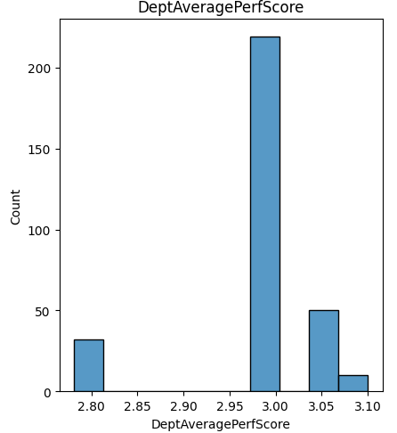
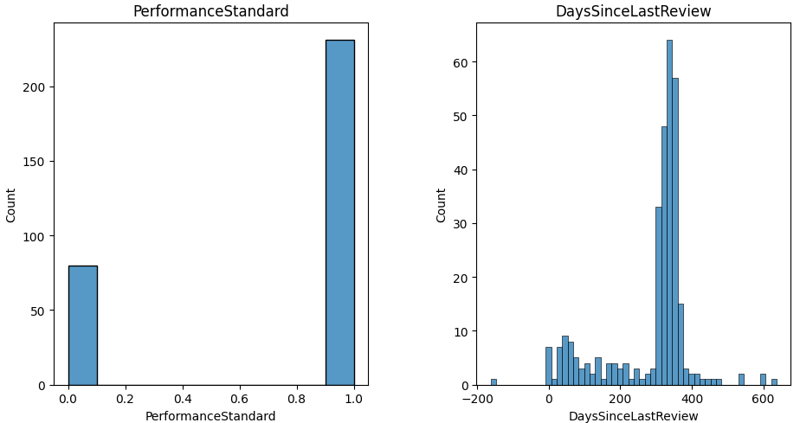
Feature Engineering
Case Study: People Analytics
9
The dataset lacks critical KPIs and employee context, limiting turnover insights and model accuracy. Engineering this data would improve predictive power and business decision-making.
Other Note: Dataset records from 2012 to 2019, hence the reference date is December 31, 2019.
Performance Benchmarking
DeptAveragePerfScore & PerformanceStandard
Measures if an employee is performing consistently with the standards of the rest of the department.
Identifies training needs and compensation.
Days Since Last Review
Identifies overdue performance evaluations.
May correlation with retention risk.

Slide 11
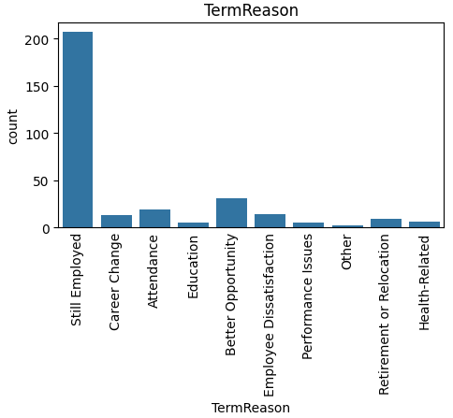
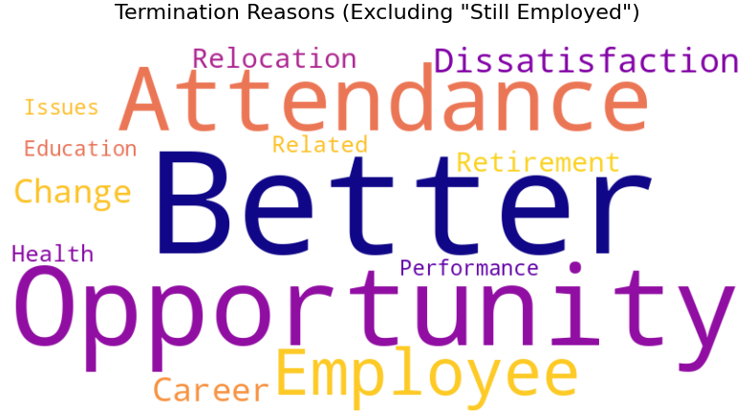
Feature Engineering
Case Study: People Analytics
10
The dataset lacks critical KPIs and employee context, limiting turnover insights and model accuracy. Engineering this data would improve predictive power and business decision-making.
Other Note: Dataset records from 2012 to 2019, hence the reference date is December 31, 2019.
Termination Reason
Simplifies analysis by grouping similar termination reasons.
Helps supports targeted retention strategies.

Slide 12
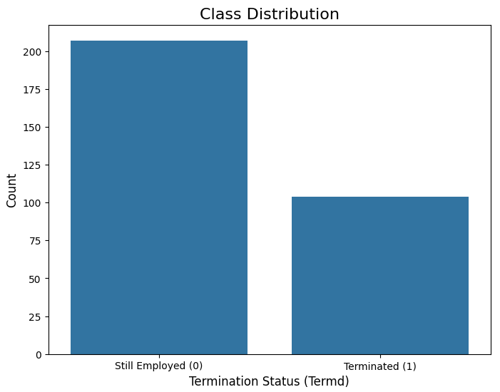
Summary
Case Study: People Analytics
11
Feature engineered columns (added 9 columns, went from 39 to 44 columns)
Cleaned the dataset by handling missing and duplicate entries, leading spaces, and misleading values.
Visualized the data distributions and some correlations.
Overall:
Rich HR data enabling deep employee insights for business decisions.
Lacks temporal metrics - cannot track progression in salary, promotions, or performance over time.

Slide 13
Data Preprocess
Case Study: People Analytics
12
Winsorization
EngagementSurvey, EmpSatisfaction, Absences, DaysLateLast30, Salary, Age
Reduces outlier impact (e.g., extreme salaries) while preserving the data shape/info.
Log Transformation
SpecialProjectsCount, DaysLateLast30, Absences, Salary
Fixes skewed distributions for model.
Standardization & Normalization
Model: Did not use because will be using tree-based models where scaling is unnecessary.
Statistical Test: Did not use because alters original distributions making interpretation harder for some tests.

Slide 14
Statistical Analysis
Case Study: People Analytics
Employee Engagement Rate Analysis
13
Is there a relationship between employee satisfaction (engagement) and their performance?
How is the employee engagement rate based on age, gender, and race?
Conducted Chi-test to compare categorical relationships employee demographics (race, gender, age) or employee satisfaction vs. employee performance
No significant link between satisfaction and race/gender/age (*p* > 0.05).
Strong correlation between satisfaction and performance (*p* < 0.001).
High performers cluster in "Fully Meets" (satisfied) and "Exceeds" (very satisfied) categories.
Improving satisfaction directly boosts productivity and retention of top talent.
Implement employee surveys to identify satisfactory/motivation drivers
Reward consistency
Address low performers by mandating biweekly check-in to discover root cause.
Notes:
Diversity initiatives are not conflicting with employee engagement.
Satisfaction drivers are universal, not demographic-specific.

Slide 15
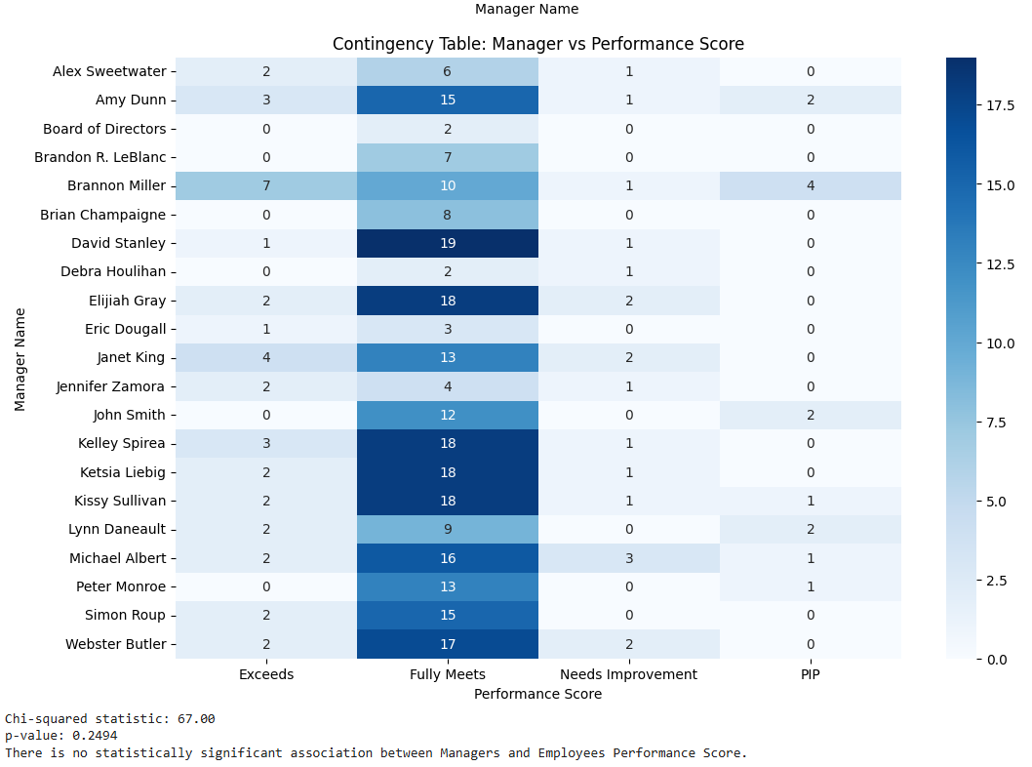
Statistical Analysis
Case Study: People Analytics
Management Analysis
14
Is there any relationship between who a person works for and their performance score? What about their satisfaction?
Conducted Chi-test to compare managers vs. employee’s performance score.
No Significant Association (p = 0.2494): Employee performance scores are consistent across managers.
Performance is driven by systemic factors (e.g., training programs, role clarity) rather than individual managers.
Notes:
Diversity initiatives are not conflicting with employee engagement.
Satisfaction drivers are universal, not demographic-specific.

Slide 16
Statistical Analysis
Case Study: People Analytics
Salary Analysis
15
Are there areas of the company where pay is not equitable?
Conducted Mann-Whitney U test to find a difference between salaries and genders.
Avoided Shapiro-Wilk test, Salary did not have normal distribution
No Significant Difference: Mann-Whitney U test (*p* = 0.198) confirms salaries are equitable across genders.
Salaries show no bias by race, diversity status, or gender.
Notes:
Diversity initiatives are not conflicting with employee engagement.
Satisfaction drivers are universal, not demographic-specific.

Slide 17
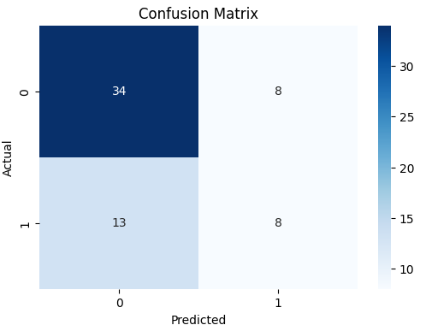
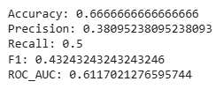
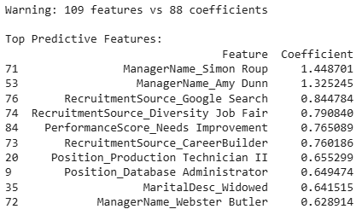
Benchmark Model
Case Study: People Analytics
16
Logistic Regression
Simple, interpretable and reveals baseline impacts/features
Struggles with positive class prediction
Improve by:
Feature selection/engineering to reduce dimensionality and address multicollinearity
Address class imbalance
Important Features
Manager Impact: Employees under Simon Roup, Amy Dunn, and Webster Butler show significantly higher turnover risk.
Recruitment Source: Hires from Google Search and Diversity Job Fairs correlate with turnover.
Performance & Role Risks: Employees in "Needs Improvement" performance category and roles like Production Technician II are higher risk.
Notes:
Diversity initiatives are not conflicting with employee engagement.
Satisfaction drivers are universal, not demographic-specific.

Slide 18
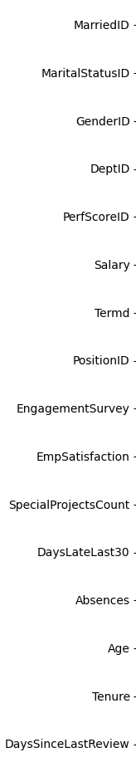
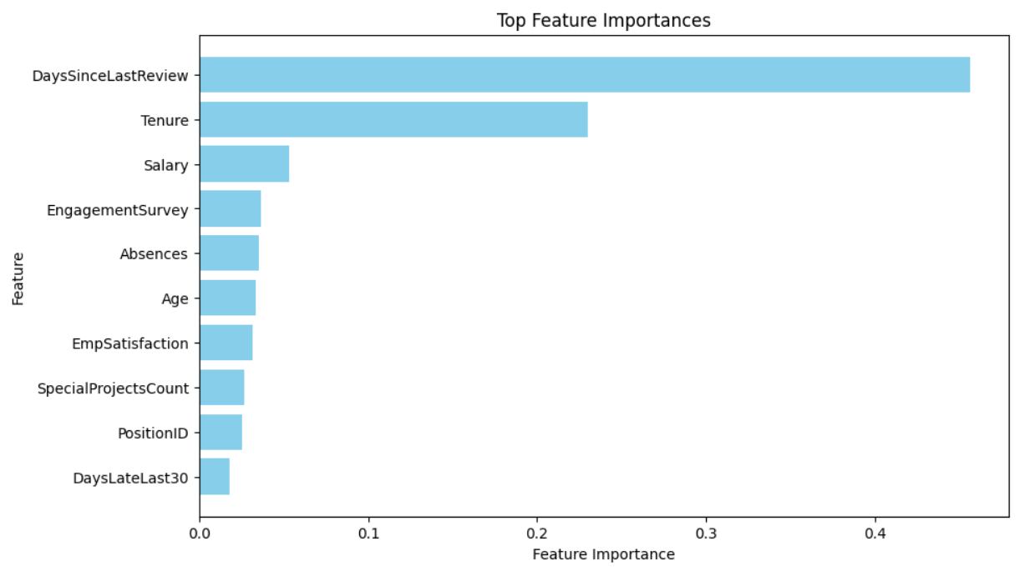

Tuned Model
Case Study: People Analytics
17
1st Random Forest
Captures non-linear relationships
Class Imbalance
Applied smote
Feature Selection
Removed descriptive features, used their ID features instead.
Avoided one-hot encoding
Reduced features: 109→16
Has dominant feature.
Notes:
Diversity initiatives are not conflicting with employee engagement.
Satisfaction drivers are universal, not demographic-specific.

Slide 19
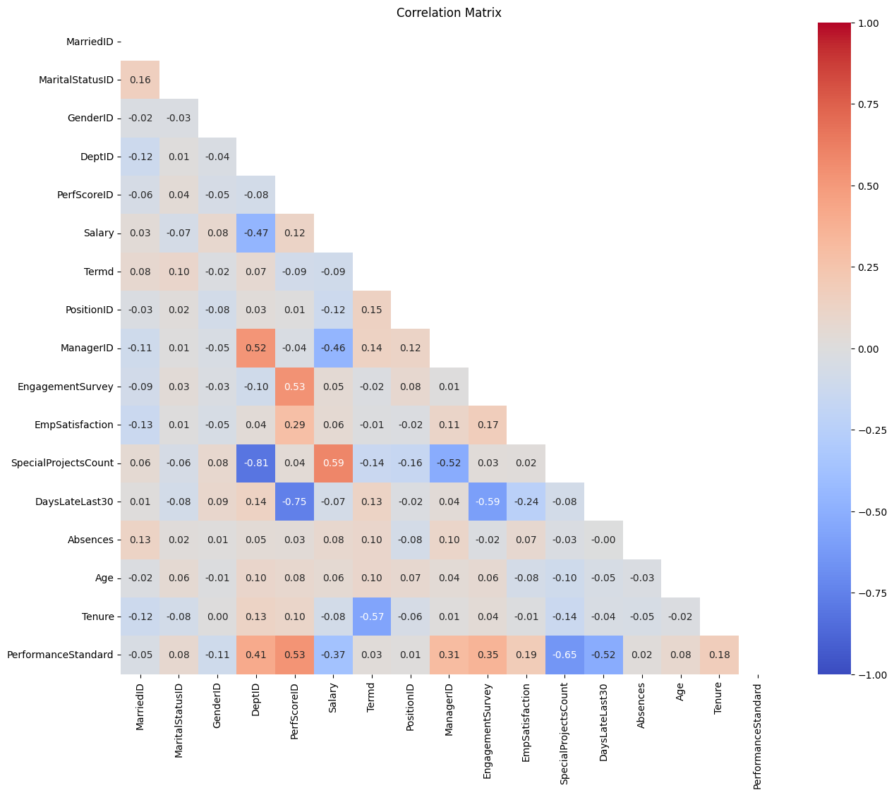
Tuned Model
Case Study: People Analytics
18
2nd Random Forest
Class Imbalance
Applied smote
Feature Selection
Added: Manager ID, PerformanceStandard, RecruitmentSource
Removed DaysSinceLastReview
Reduced features: 109→29
Notes:
Diversity initiatives are not conflicting with employee engagement.
Satisfaction drivers are universal, not demographic-specific.

Slide 20
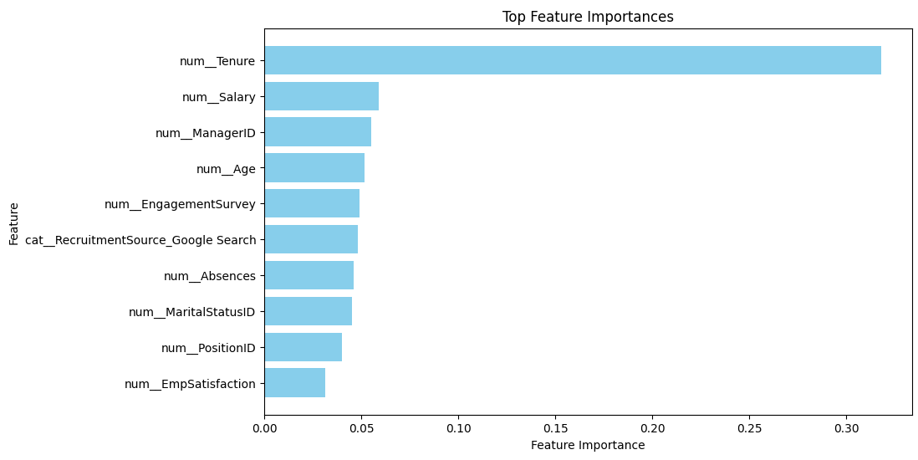

Tuned Model
Case Study: People Analytics
19
2nd Random Forest
AUC=90.5%
model excels at ranking employees by turnover risk (e.g., distinguishing high-risk vs. low-risk employees).
Precision=71.4%
28.6% of flagged "at-risk" employees are false positives (~3 in 10 flagged employees are false positives).
Ensures few actual turnover cases are missed, but may lead to unnecessary retention costs if overacted upon.
Recall=93.8%
Model can confidently be used to provide preventative measures:
Prioritize stay interviews for high-risk employees.
Allocate retention bonuses strategically.
Hypertuning
Saw no improvement/same metric results
N_estimaters, max_depth, min_split, min_leaf
Notes:
Diversity initiatives are not conflicting with employee engagement.
Satisfaction drivers are universal, not demographic-specific.

Slide 21
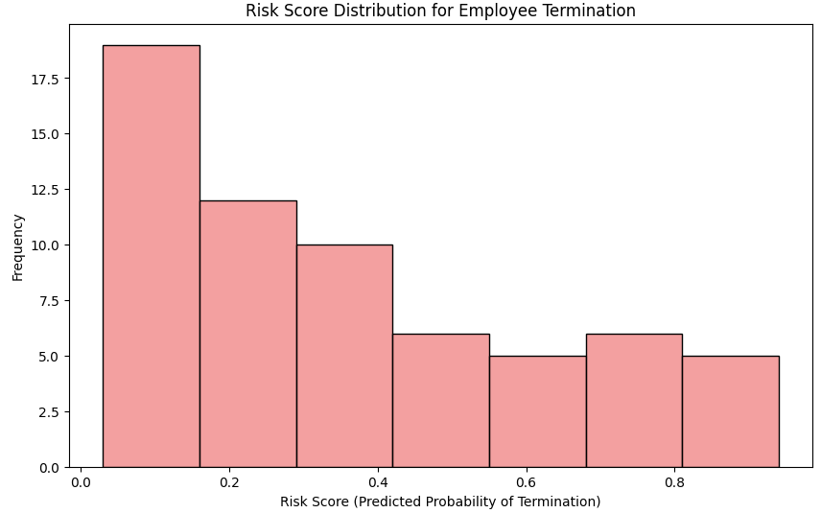
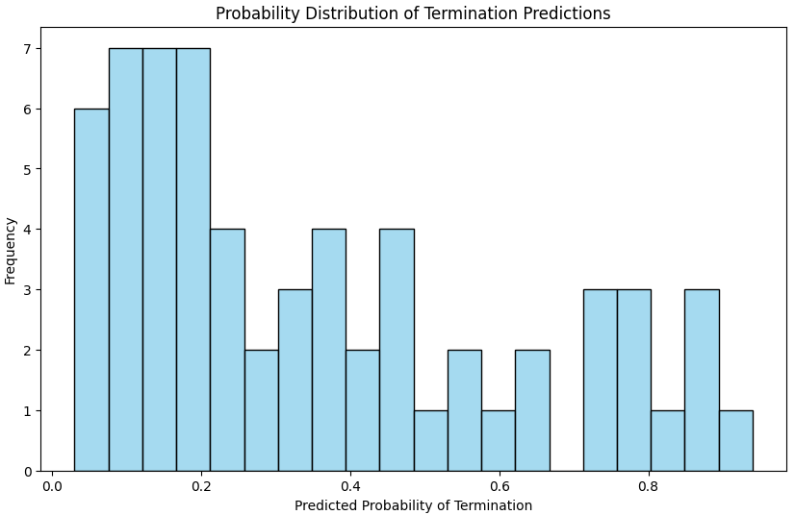
Predictive Model
Case Study: People Analytics
20
Majority are low risk
Most employees have a low predicted probability of termination.
The model identifies that the workforce, overall, is stable.
Smaller medium/high-risk population
Few risk scores between 0.4 and 0.9, indicating potential turnover.
These at risk employees require intervention methods.
Flag and engage with at-risk employees
Determine resource allocation
Notes:
"This graph visualizes the termination risk scores generated by our predictive model. Most employees fall into the low-risk category, which aligns with our current retention trends. However, the model identifies a smaller group—roughly 20–30%—with medium to high risk of leaving. By acting on these insights, we can proactively retain key talent before issues escalate."

Slide 22
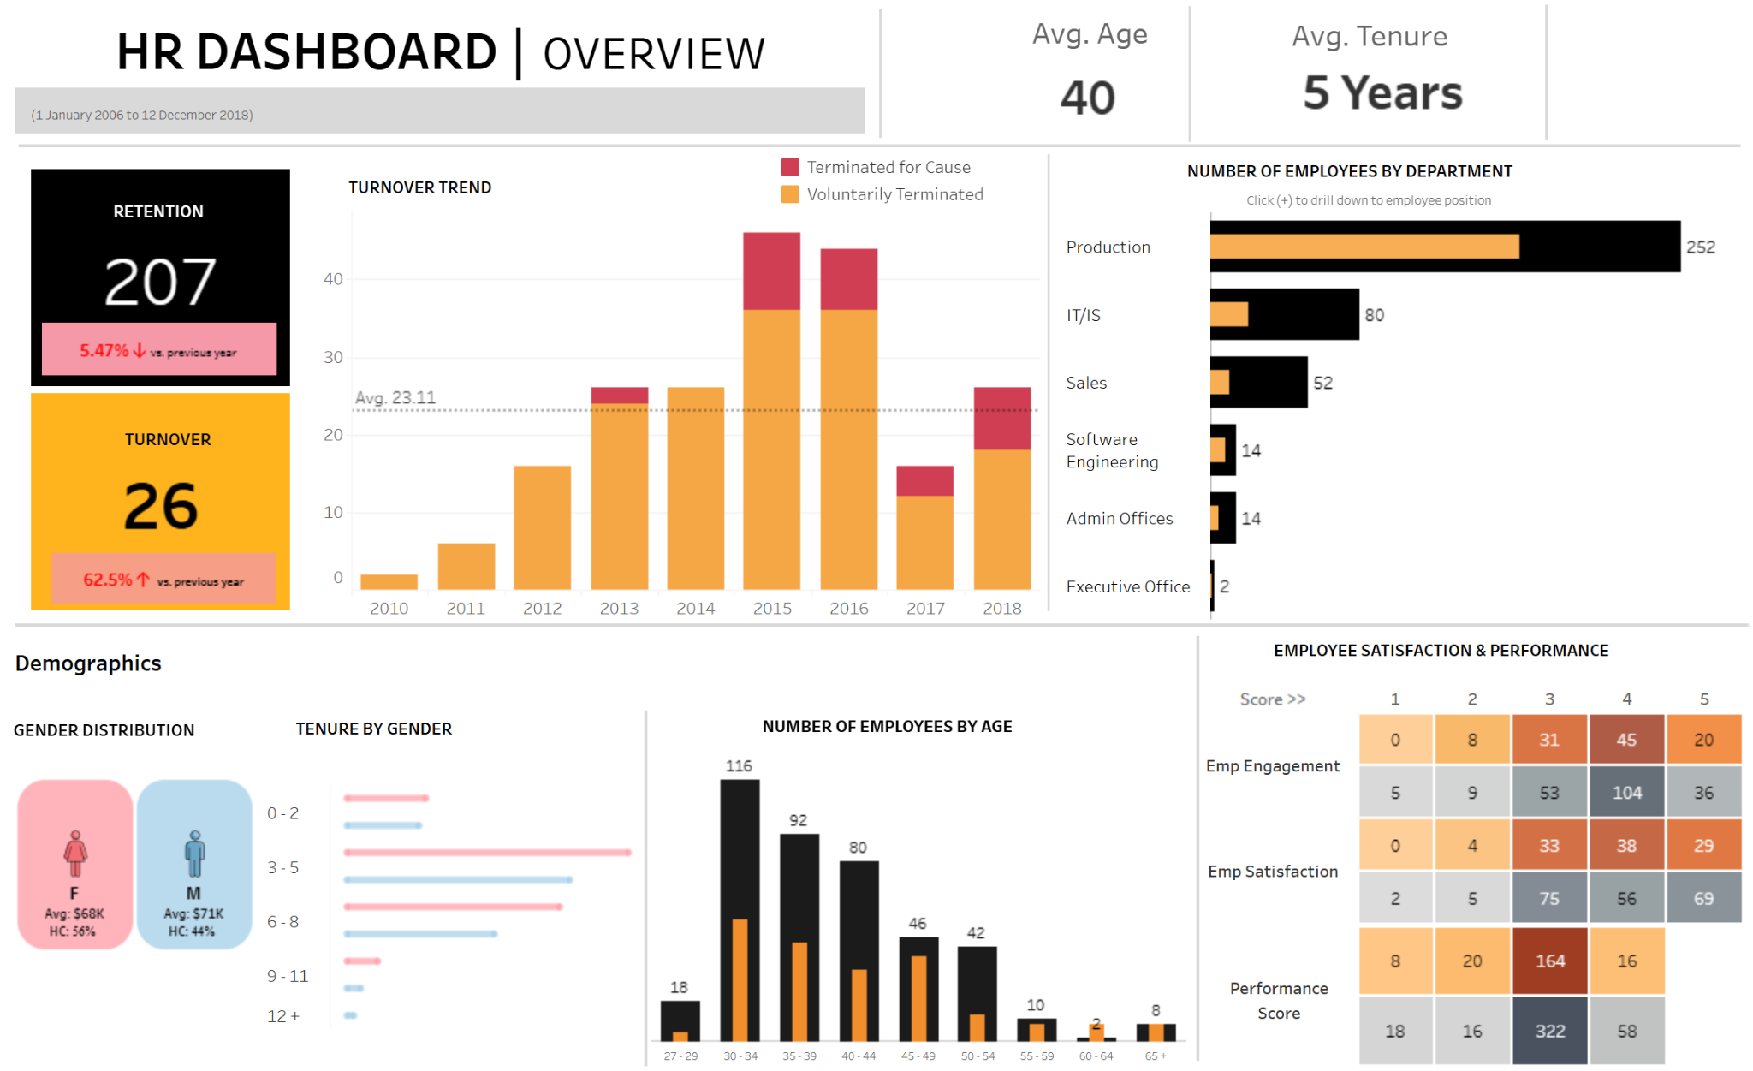
Interactive Dashboard
Case Study: People Analytics
21

Slide 23
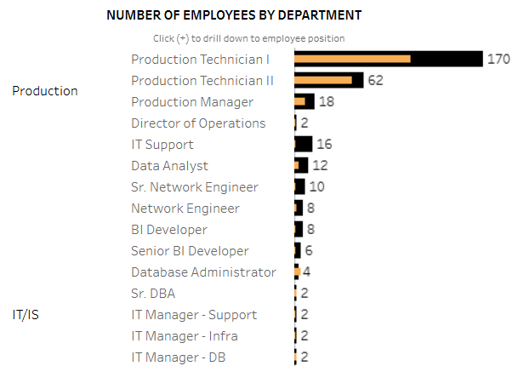
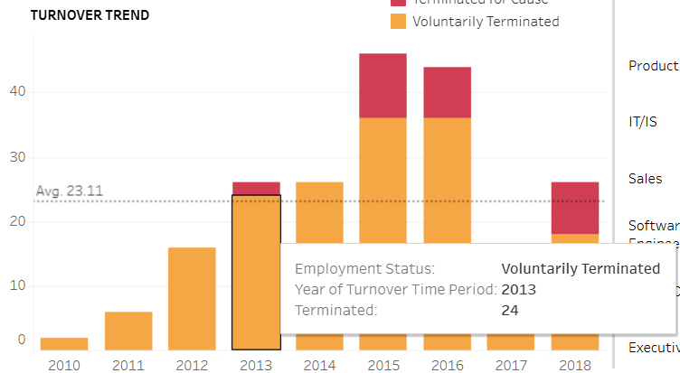
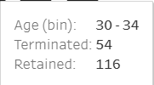
Interactive Dashboard
Case Study: People Analytics
22

Slide 24
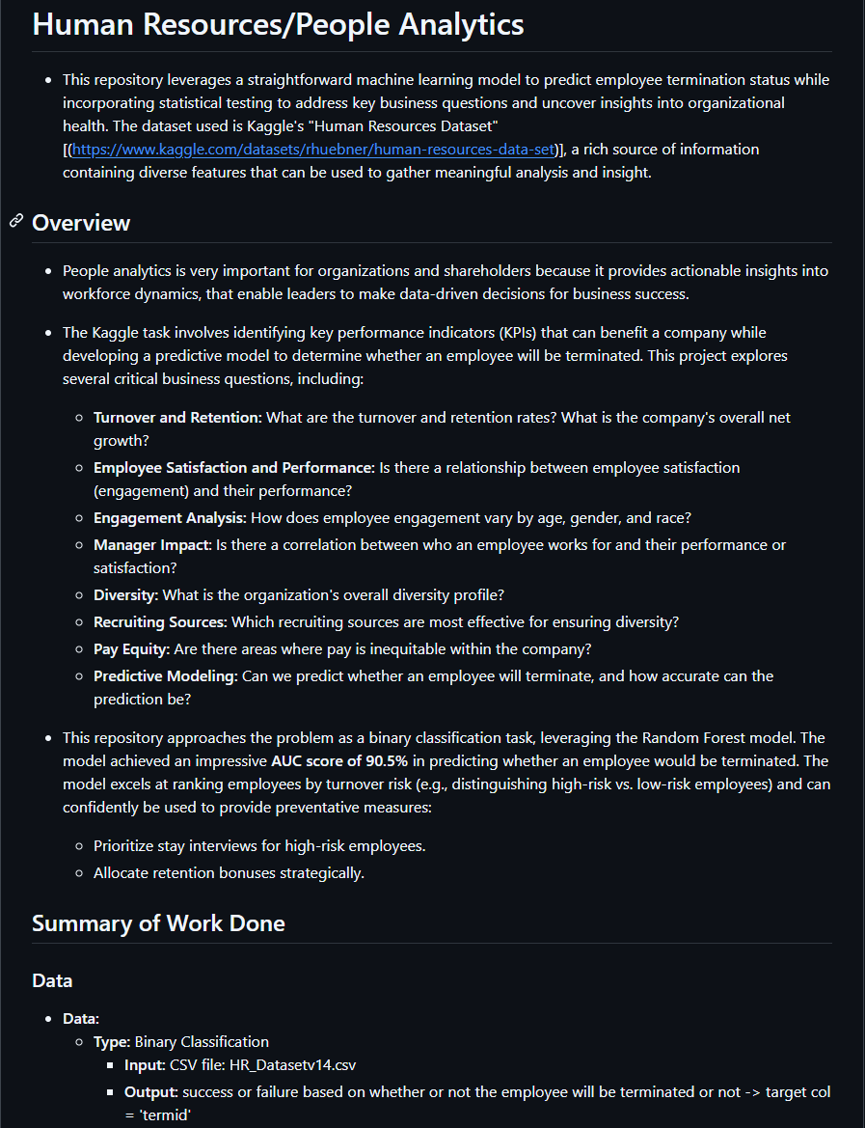
Github
Case Study: People Analytics
23

